Slide 1

Process Mining Virtual Internship
by
K.GREESHMA
Roll No. 214G1A3220
Department of Computer Science and Engineering (Data Science)
Srinivasa Ramanujan Institute of Technology
(Affiliated to JNTUA & Approved by AICTE) (Accredited by NAAC with ‘A’ Grade & Accredited by NBA (EEE, ECE & CSE)
Rotarypuram Village, B K Samudram Mandal, Ananthapuramu – 515701.
2023 - 2024

Slide 2



Contents
Process Mining Virtual Internship
Course Objective
Introduction
Technology
Applications
Modules
Real Time applications
Learning outcomes
GitHub Link
Queries
214G1A3220

Slide 3
Course Objective
Process Mining Virtual Internship
The objectives of the Process Mining Virtual Internship are to equip participants with a comprehensive understanding of process mining concepts and methodologies.
Throughout the internship, participants will gain hands-on experience in utilizing process mining tools to analyze event log data, create process models, and extract valuable insights.
Process Discovery
Collaboration and Remote Work Skills
Real-World Applications
Critical Thinking
Problem Solving
Understand Different Process Mining Concepts
214G1A3220

Slide 4
Introduction
Process Mining Virtual Internship
What is process Mining?
Process mining is a technique designed to discover, monitor and improve real processes by extracting readily available knowledge from the event logs of information systems.
It is important because the reality of the problem is sometimes bigger to understand to extract an exact solution, in such situations this technology helps in making the concept into the reality.
Process Mining is often described as occupying the area between business process management and data mining. The speed, accuracy, and auditability these technologies deliver can result in significant cost saving and much faster time to mark.
behind everything your organization does: buying, selling, paying, collecting, shipping, and so on. When
214G1A3220

Slide 5
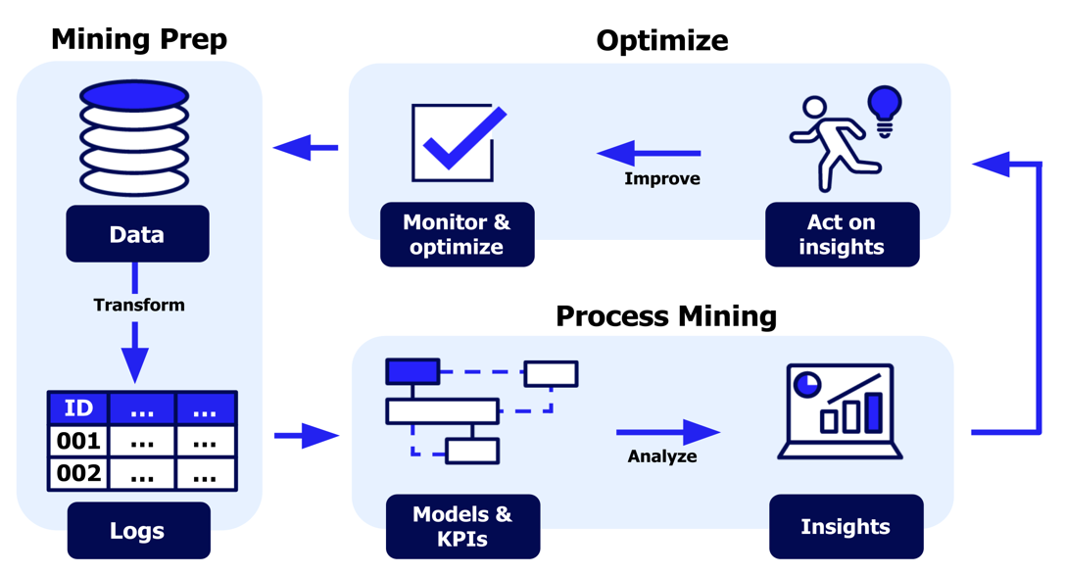
Technology
Process Mining Virtual Internship
Process mining technology is a data-driven approach to analyze, monitor, and optimize business processes using event data stored in various information systems. It aims to extract valuable insights and knowledge from these data to improve process efficiency, compliance, and overall performance.
Process mining involves the following key steps:
1. Data Extraction
2. Data Pre-processing
3. Process Discovery
4. Conformance Checking
5. Process Monitoring
6. Predictive Analysis
214G1A3220

Slide 6
Different Types Of Technologies:
Process Mining Virtual Internship
Data mining: Data mining is the process of extracting knowledge from data. In the context of process mining, data mining is used to identify patterns and trends in event data.
Machine learning: Machine learning is a type of artificial intelligence that allows computers to learn without being explicitly programmed. In the context of process mining, machine learning is used to build models that can predict future behavior of processes.
Process modeling: Process modeling is the process of representing a process in a graphical or textual form. In the context of process mining, process modeling is used to create a graphical representation of the actual process, as opposed to the as-designed process.
Business intelligence: Business intelligence (BI) is a set of technologies and processes for collecting, analyzing, and providing insights into data. In the context of process mining, BI is used to visualize and explore the results of process mining analysis.
214G1A3220

Slide 7
Modules
Process Mining Virtual Internship
How does process mining works.
Main components of process mining.
How to start a project in process mining.
Why Companies need Process Mining.
Benefits of process mining.
Examples of process mining.
Best process mining software.
Process Mining Tools and Software.
214G1A3220

Slide 8
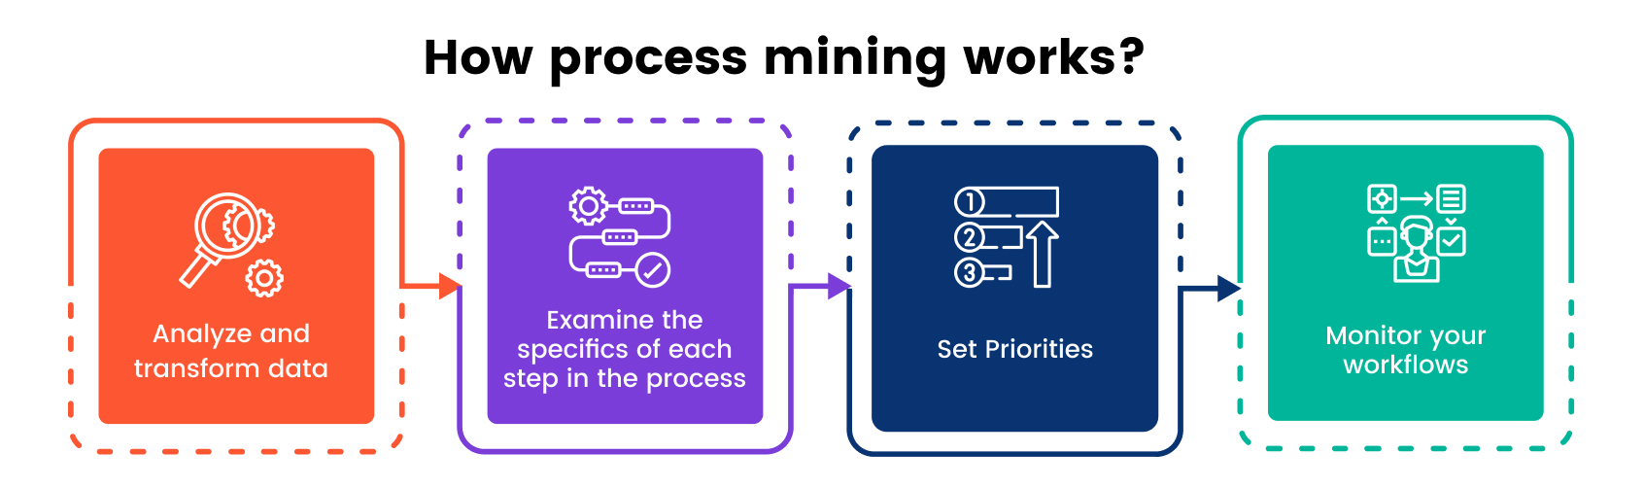
How Does Process Mining Works?
Process Mining Virtual Internship
behind everything your organization does: buying, selling, paying, collecting, shipping, and so on. When
214G1A3220

Slide 9
How Does Process Mining Works?
Process Mining Virtual Internship
When humans and software robots work with IT systems, their activities are recorded by those systems.
Process mining reads this data, converts it into an event log, and then creates visualizations of the end-to-end process, along with insightful analytics.
An event log contains each step performed during the process (the activity), the time at which the event occurred (the timestamp), and for which instance of the process (the case ID).
Using this event log, algorithms generate a process model that shows the process as it really is - including the timing of each step and all variations.
Other data science methods can be applied to further improve this model, The result is then used for process discovery, conformance testing and process improvement.
behind everything your organization does: buying, selling, paying, collecting, shipping, and so on. When
214G1A3220

Slide 10
Main Components Of Process Mining
Process Mining Virtual Internship
Process discovery: There are a variety of process discovery techniques available. Some of the most common techniques include token-based discovery, event-based discovery, and rule-based discovery.
Conformance checking: Conformance checking can be done manually or automatically. Manual conformance checking involves comparing the actual process to the as-designed process using a checklist. Automatic conformance checking uses process mining techniques to identify deviations from the standard process.
Process enhancement: Process enhancement can be done using a variety of techniques, such as process redesign, process automation, and process optimization.
Business processes are the lifeblood of your company. There’s a process behind everything your organization does: buying, selling, paying, collecting, shipping, and so on. When
214G1A3220

Slide 11
How to Start a Project in Process Mining
Process Mining Virtual Internship
To start a project in the stream of process mining one need to follow some basic requirements they are classified as follows.
Determine Problem: Identify the problem of importance to the business that can realistically be addressed with process mining.
Identify the Data: Identify the data sources that need to be fully understood to address the business process issues under consideration.
Setting Pilot Project: Set up a pilot project to prove the potential value of a process mining solution.
Accept Truth: Accepting the results of the analysis, as process mining provides, among other things, a clear picture based on facts.
Business processes are the lifeblood of your company. There’s a process behind everything your organization does: buying, selling, paying, collecting, shipping, and so on. When
214G1A3220

Slide 12
Why Companies need Process Mining?
Process Mining Virtual Internship
Visibility: Process mining provides a clear, visual representation of how processes are executed, revealing the true sequence of activities and interactions.
Performance Analysis: It allows for the measurement of process performance metrics, aiding in monitoring and continuous improvement efforts.
Efficiency and Cost Savings: Through process optimization, companies can reduce operational costs and enhance overall efficiency.
Root Cause Analysis: Process mining helps uncover the underlying causes of process issues, enabling companies to address problems at their source.
Risk Mitigation: By identifying process deviations and non-compliance, process mining helps companies mitigate risks related to fraud, errors, and other issues.
Business processes are the lifeblood of your company. There’s a process behind everything your organization does: buying, selling, paying, collecting, shipping, and so on. When
214G1A3220

Slide 13
Benefits of Process Mining?
Process Mining Virtual Internship
Reduced costs: Process mining can help organizations to identify and eliminate waste in their processes. This can lead to significant cost savings.
Improved customer satisfaction: Process mining can help organizations to improve the customer experience by identifying and addressing issues in their processes.
Real-time monitoring: Process mining can be used to monitor processes in real time, which can help organizations to identify and address issues as they occur.
Enhanced decision-making: Process mining can help organizations to make better decisions about their processes by providing insights into the actual process flow.
Reduced risk: Process mining can help organizations to reduce the risk of errors and fraud by identifying and addressing deviations from the standard process.
214G1A3220

Slide 14
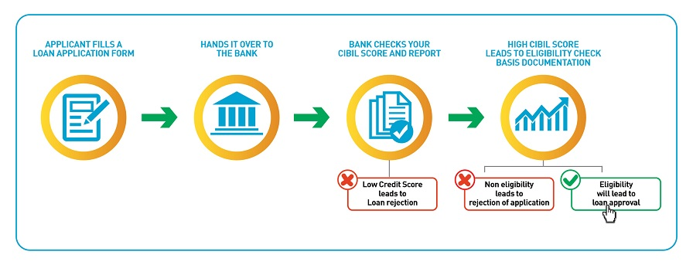
Examples of Process Mininng
Process Mining Virtual Internship
Loan Approval in Banking:
Banks can analyze the loan approval process using process mining. By tracking each step, from application submission to final decision, they can pinpoint delays, redundant steps, or areas where customers drop out of the process. This can lead to quicker loan processing and improved customer satisfaction.
Business processes are the lifeblood of your company. There’s a process behind everything your organization does: buying, selling, paying, collecting, shipping, and so on. When
214G1A3220

Slide 15


Best Process Mining Software
Process Mining Virtual Internship
Good process mining software solutions are characterized by three functions.
A process mining solution should have strong detection capabilities. It should be able to search event logs to track what employees are doing and then create an appropriate process model by generating process maps of the entire business flow.
In addition, the solution should have robust conformance checking that analyzes event logs to ensure that actions match process models.
Ultimately, though, which software is right for the job depends on the size of the company, its business needs, and its goals.
Business processes are the lifeblood of your company. There’s a process behind everything your organization does: buying, selling, paying, collecting, shipping, and so on. When
Process
detection
Conformity
testing
Performance
analysis and
improvement
214G1A3220

Slide 16
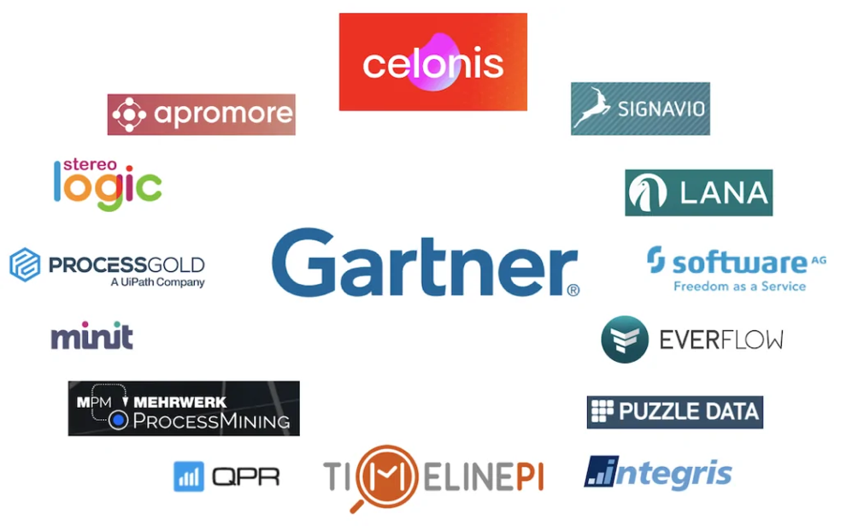
Process Mining Tools And Software
Process Mining Virtual Internship
Tools:
Apromore
ABBYY Timeline
ARIS Process Mining
BusinessOptix
Celonis
Fluxicon
Minit
IBM
UiPath
Bizagi
Business processes are the lifeblood of your company. There’s a process behind everything your organization does: buying, selling, paying, collecting, shipping, and so on. When
214G1A3220

Slide 17
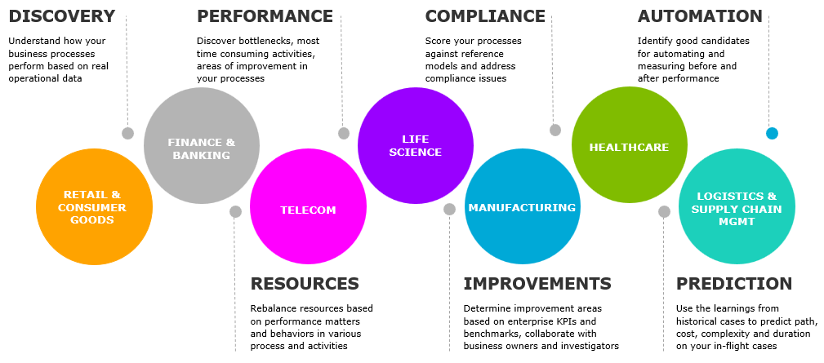
Real Time Applications
Process Mining Virtual Internship
Retail & Consumer Goods
Financial & Banking
Telecommunications
Life Science
Manufacturing
Healthcare
Logistics
Supply Chain Management
Retail
Digital Transformation
214G1A3220

Slide 18
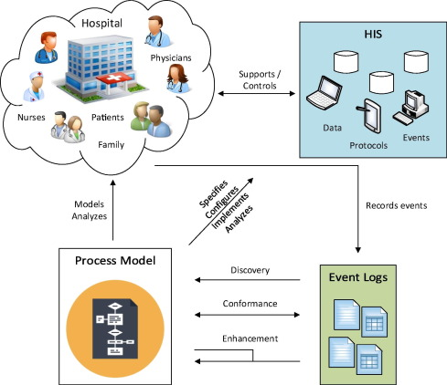
Real Time Applications
Process Mining Virtual Internship
1. Healthcare:
The risks associated with preserving population health and achieving individual patient journey objectives rise as data about patient experiences and results keep growing. Process mining supports the delivery of effective and high-quality end-to-end patient journeys for healthcare organizations dealing with the exponential growth of data, from before a first doctor appointment through treatment regimens to closed treatment cases.
214G1A3220

Slide 19
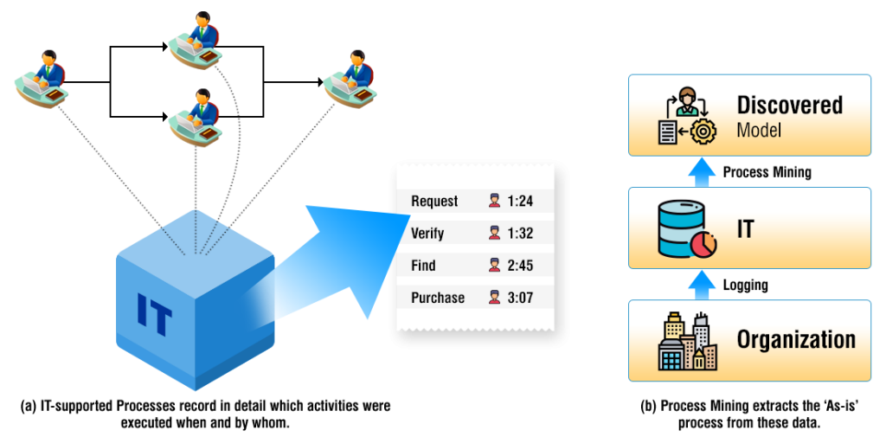
Real Time Applications
Process Mining Virtual Internship
2. Telecommunications:
As subscriber quantities increase and activations become more and more automated, there is a greater danger of unsuccessful activations. When telecom companies get more orders, process mining gives them the chance to identify pricey issues and client blowback in their Order-to-Activation processes. Optimizing resource allocation is essential in telecommunication.
214G1A3220

Slide 20
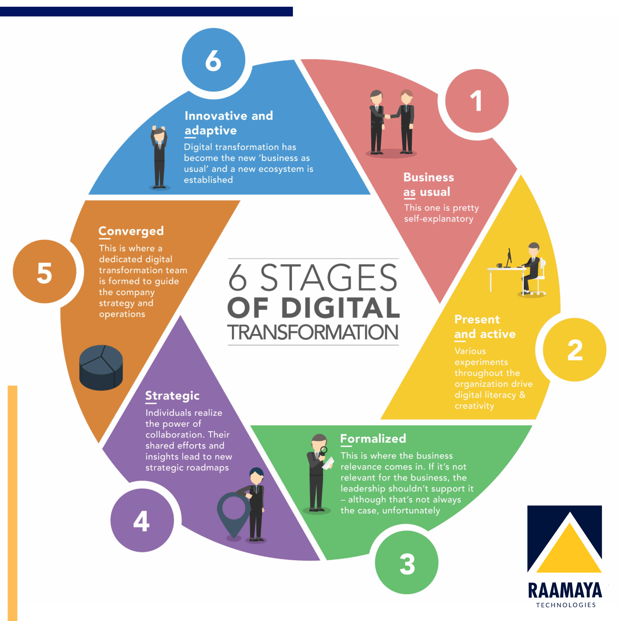
Real Time Applications
Process Mining Virtual Internship
3. Digital Transformation:
Process mining is frequently used in larger-scale digital transformation initiatives because it can give you the precise insights needed for process improvement, allowing systems to run more quickly, smoothly, and efficiently, as well as objective data-driven insights into the causes of delays and inefficiencies within business processes.
214G1A3220

Slide 21
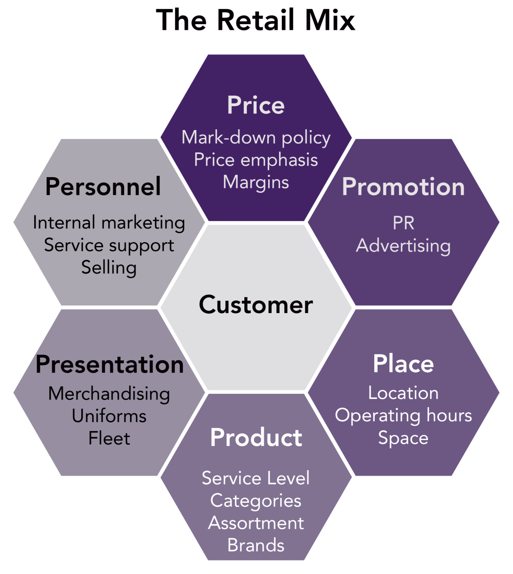
Real Time Applications
Process Mining Virtual Internship
4. Retail:
Due to technology or process problems, retail businesses have seen expensive consumer fallout from complicated e-commerce operations. Process mining assists merchants in ensuring that consumers can complete transactions efficiently and without issues despite rising transaction volumes.
214G1A3220

Slide 22
Learning Outcomes
Process Mining Virtual Internship
Process Mining aims to discover, monitor, and improve processes based on the actual data rather than relying solely on models or assumptions.
Problem Solving: Become adept at tracing process variations back to their root causes, enabling effective troubleshooting.
Process Discovery: Automatically uncover existing processes from event data for deeper insights.
Process Understanding: Gain a comprehensive view of end-to-end process flows through visual representations
Quality Assurance: Ensure adherence to documented processes by identifying and addressing deviations through data-driven insights.
Data Driven Decisions: Make well-grounded choices by assessing key performance indicators (KPIs) through analysis.
Business processes are the lifeblood of your company. There’s a process behind everything your organization does: buying, selling, paying, collecting, shipping, and so on. When
214G1A3220

Slide 23
Conclusion
Process Mining Virtual Internship
In conclusion, process mining emerges as a powerful and transformative approach that unlocks the hidden potential within an organization's operational landscape.
By delving deep into the data generated during process execution, process mining offers a dynamic lens through which processes can be understood, analyzed, and optimized.
This revolutionary technique enables a shift from assumptions and theoretical models to a reality-based understanding of how processes truly function.
This journey through process mining fosters collaboration across departments, enlightening teams with a shared language for process discussions.
Business processes are the lifeblood of your company. There’s a process behind everything your organization does: buying, selling, paying, collecting, shipping, and so on. When
214G1A3220

Slide 24
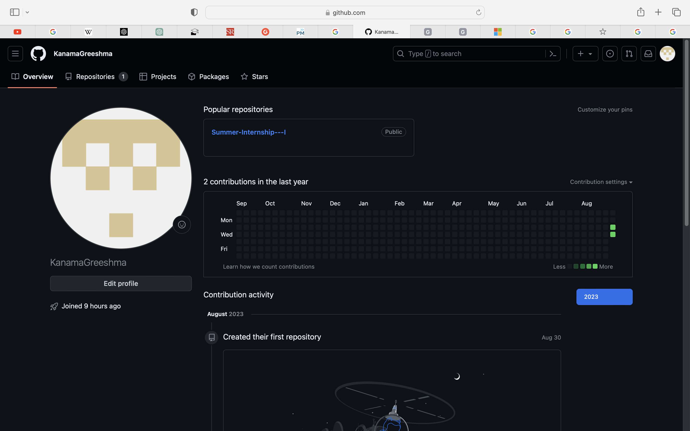
Git Hub Dashboard
Process Mining Virtual Internship
Repository Name : Summer Internship – I
Git Hub Link: //github.com/KanamaGreeshma
214G1A3220

Slide 25
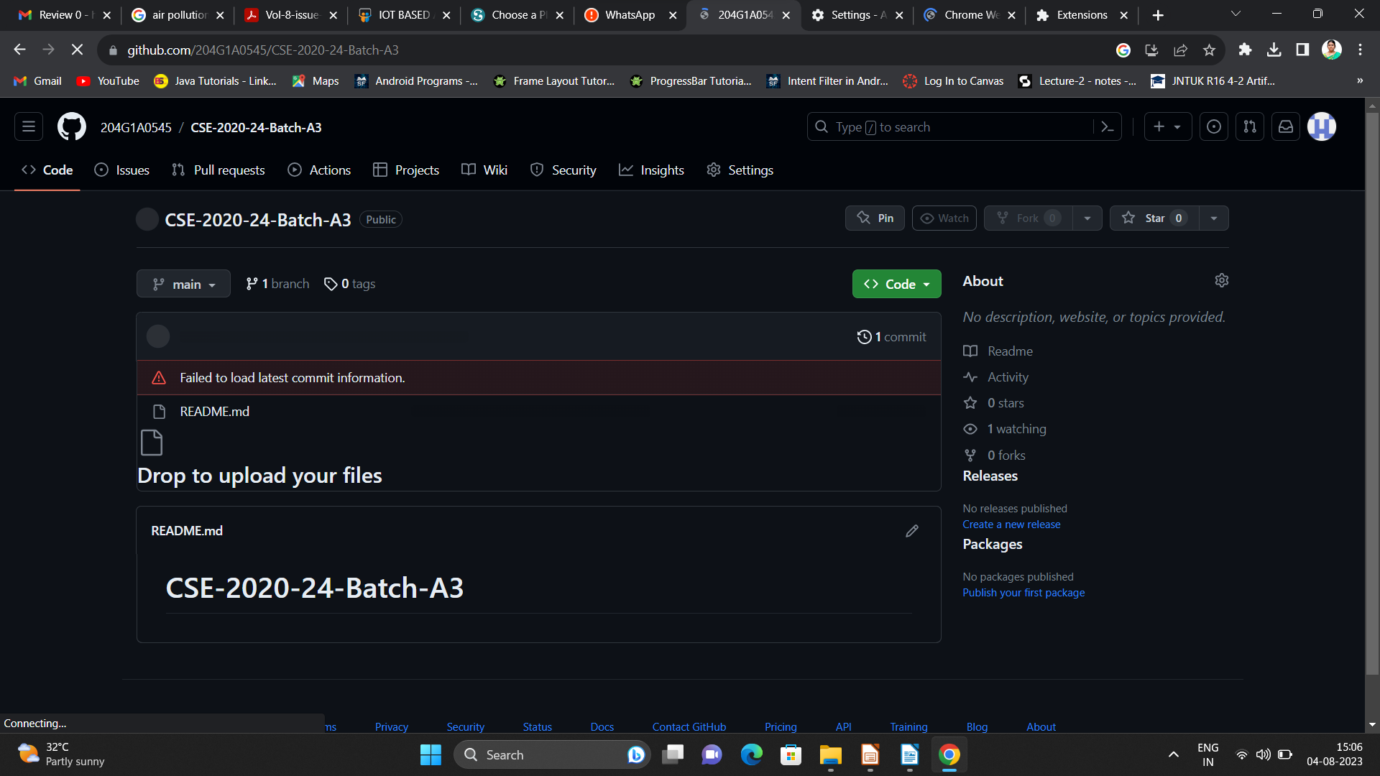

Git Hub Dashboard
Process Mining Virtual Internship
214G1A3220

Slide 26
Process Mining Virtual Internship
Any Queries?
214G1A3220

Slide 27
Process Mining Virtual Internship
Thank You!!!
214G1A3220

